Slide 1
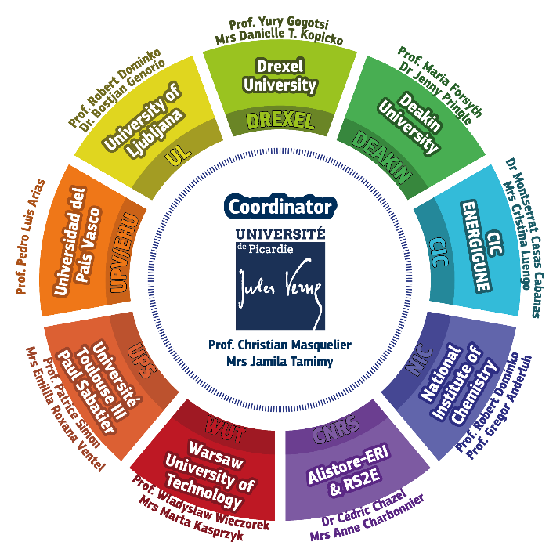
European MASTER COURSE MESC+
ERASMUS MUNDUS EMJMD (2018-2024)
https://www.u-picardie.fr/mundus-mesc/
2-years program in English (3 semesters of Class, 6-months Thesis)
Inorganic chemistry Characterisation techniques: XRD, Microscopy, Thermal analysis,...
Electrochemistry Thermodynamics Crystallography, Energy/hydrogen storage
Nanomaterials Intellectual Property
7 Partner Universities
Amiens (FRANCE), Toulouse (FRANCE)
Bilbao País Vasco (SPAIN)
Warsaw (POLAND)
Ljubljana (SLOVENIA)
DEAKIN (AUSTRALIA), DREXEL (USA)
RS2E and ALISTORE Networks as partners
Many Leading Companies involved
31 k€ Scholarships : DEADLINE for APPLICATION = 10 March, 2019

Slide 2
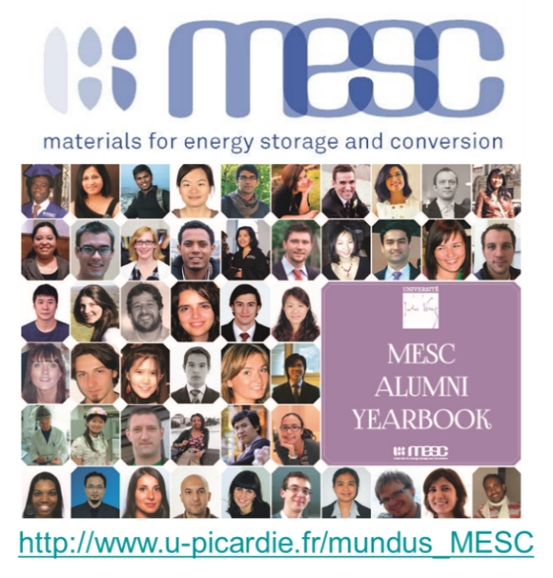
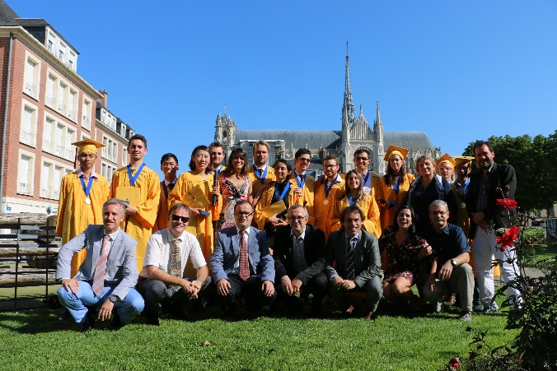
Achievements of MESC+
Running since 2004
Joint Master Degree
14 classes
256 students enrolled from 48 countries
246 graduates, strong alumni network
More than 75% go for a PhD, mostly in Europe
Strong support from the industry: 8 scholarships per year
Master Thesis topics all over Europe (Alistore, RS2E, companies)

